Slide 1
Midway Capstone Presentation:
Research Funding Gap Analysis for Program (RF-GAP)
Amanda DiBattista, Ph.D.
Research Program Analyst
Division of Neuroscience
National Institute on Aging
June 28, 2018

Slide 2





Problem
At NIH, we track the research we fund to make decisions everyday …
… But, what are we missing?
Grants
Funding
Research Articles
Outcomes
“To carry out this mission, NIH supports a balanced research portfolio to ensure high return on investment for U.S. taxpayers”
Source: www.nih.gov/about-nih/what-we-do

Slide 3
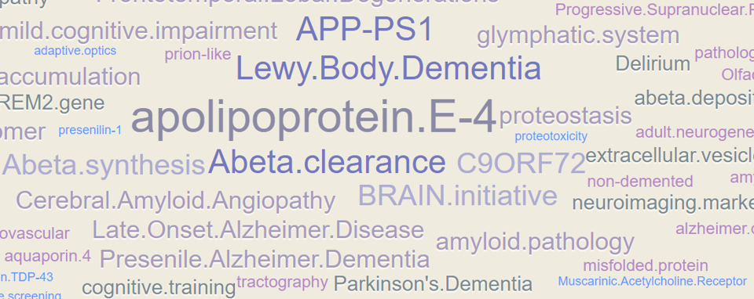
Plan of Action
Text Mining
Text Mining
Research Articles
Grants
NIH
NIH and Non-NIH
Unsupervised Learning
Research Articles
Grants
Funding
Gaps
Publication
Gaps
No Gaps

Slide 4
Variables of Interest
Type: Grant (n=1,710) or Research Article (n=336)
Funding Source:

Slide 5
Timeline
Anticipated Challenges:
1. Text Relevance, 2. Refining Clusters, 3. Data Visualization

